Slide 1
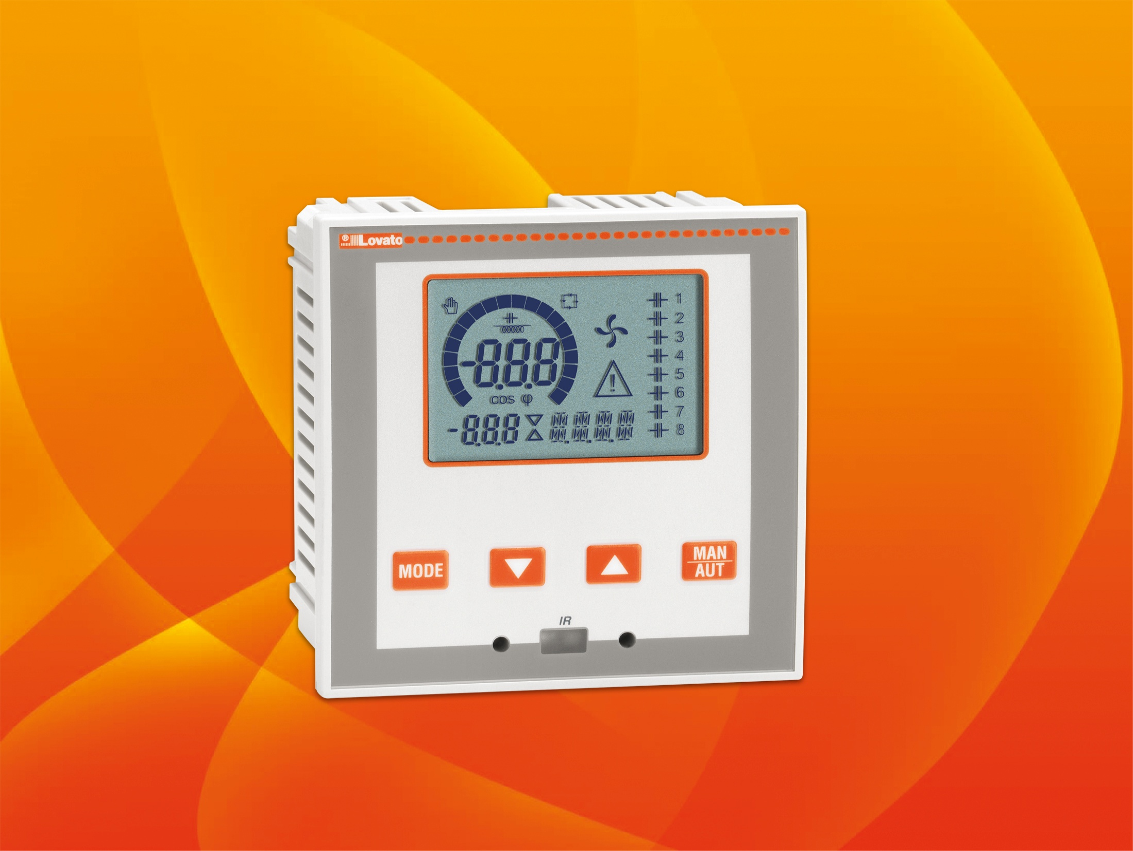


AUTOMATIC POWER FACTOR CONTROLLERS

Slide 2
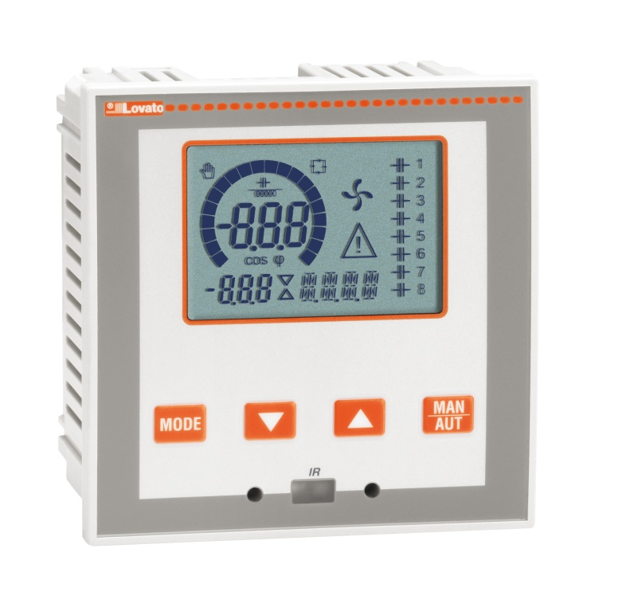
AUTOMATIC POWER FACTOR CONTROLLERS
DCRL3 - 3 BUILT-IN STEPS
DCRL5 - 5 BUILT-IN STEPS
ICON LCD WITH BACKLIGHT
Alarm messages in 6 languages
OPTICAL PORT ON FRONT
EXPANDIBILITY WITH EXP… MODULES
  RS232, RS485, USB communications interface
  Additional steps
  Digital outputs
High accuracy TRMS measurements
Wide selection of electrical measures, including voltage and current THD with harmonic analysis up to 15th order.
Wide power supply range (100-440VAC)
Voltage input separated from power supply, suitable for VT
connection in medium-voltage applications.

Slide 3
AUTOMATIC POWER FACTOR CONTROLLERS
BACKLIGHT ICON LCD
Helpful in bad lighting conditions
Main measurements regarding power factor correction viewed
The user can select the default measurement to display
With rotation mode activated all the measurements rotate automatically every 5 seconds on the display
Possibility to signal the alarm with backlight flashing.
In presence of alarm, a scrolling text appears on the display in 6 selectable languages.

Slide 4
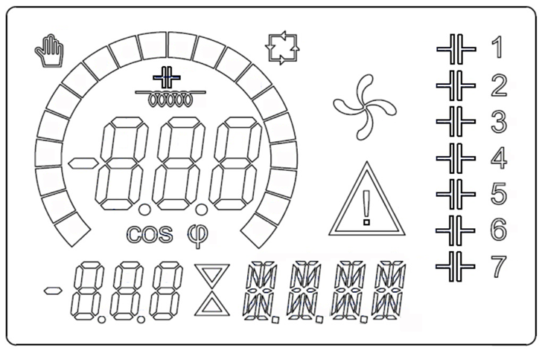
AUTOMATIC POWER FACTOR CONTROLLERS
BACKLIGHT ICON LCD
Manual mode
Inductive / capacitive
Automatic mode
Cooling fan status
Output status
Main display
Step status
Bar graph
Active alarm
Secondary display
Alphanu
meric
display

Slide 5
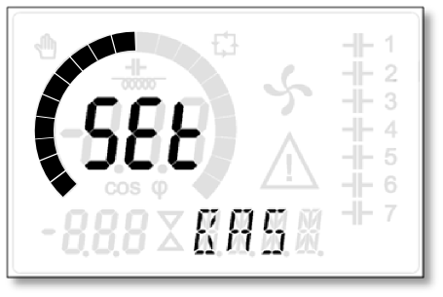
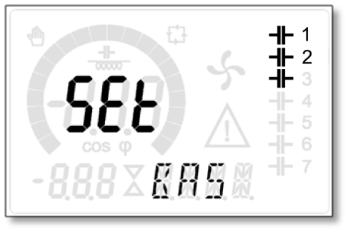
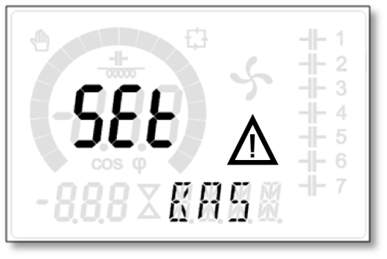
AUTOMATIC POWER FACTOR CONTROLLERS
BACKLIGHT ICON LCD SCREEN
The bar-graph can be programmed with three different viewings:
kvar ins/tot: amount of kvar actually inserted, with reference to the total reactive power installed in the panel
Curr act/nom: Percentage of actual plant current with reference to the maximum current of the CT
Delta kvar: Bar graph with center zero. It represents the positive/negative
delta-kvar needed to reach the setpoint, compared to the total kvar installed.
The icons on the right side of the display indicate the step status:
The controller displays the imminent connection or disconnection of the steps by their identification number (left) flashing
The flashing can last for some time in cases in which the insertion of a step is not possible due to the reconnection time (discharge time of the capacitor).
When an alarm is generated, the display will show an alarm icon, the code and the description of the alarm in the language selected.

Slide 6
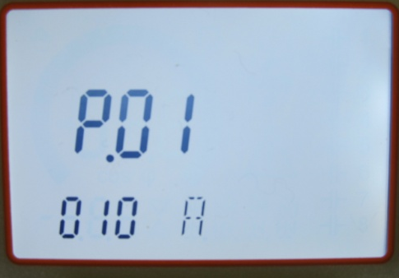
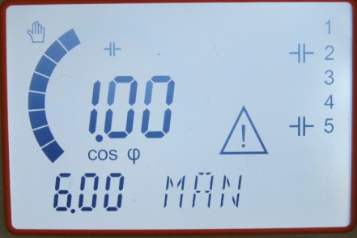
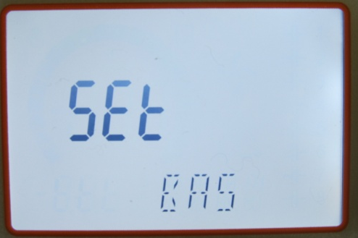
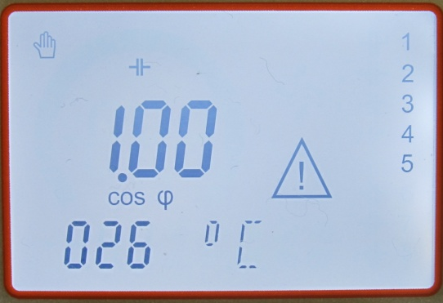
AUTOMATIC POWER FACTOR CONTROLLERS
BACKLIGHT ICON LCD
Parameters
Bar graph
Setup menu
Measurements

Slide 7

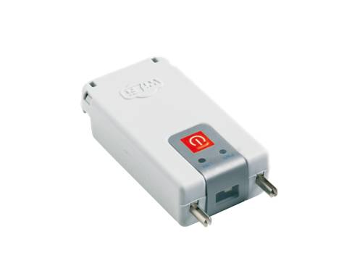
AUTOMATIC POWER FACTOR CONTROLLERS
OPTICAL PORT ON FRONT
Advantages
No need to disconnect the panel power supply to connect with the device
Electrical safety (no physical connection)
Easy access to the unit from the front.
CX01 – IR to USB converter
CX02 - IR to Wi-Fi dongle

Slide 8
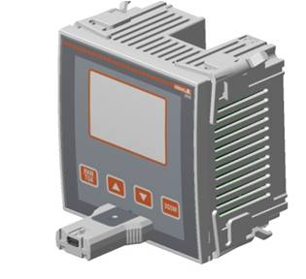

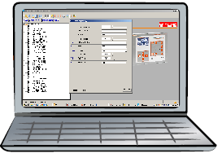



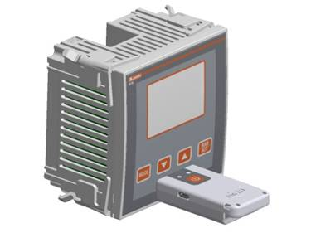


AUTOMATIC POWER FACTOR CONTROLLERS
OPTICAL PORT ON FRONT
PC link through USB (CX01) or WiFi (CX02) for:
Programming
Diagnostics
Data downloading
Firmware upgrade.
CX01
Using CX02 (WiFi), the following is possible:
Project upload/download
Controller cloning.
CX02

Slide 9
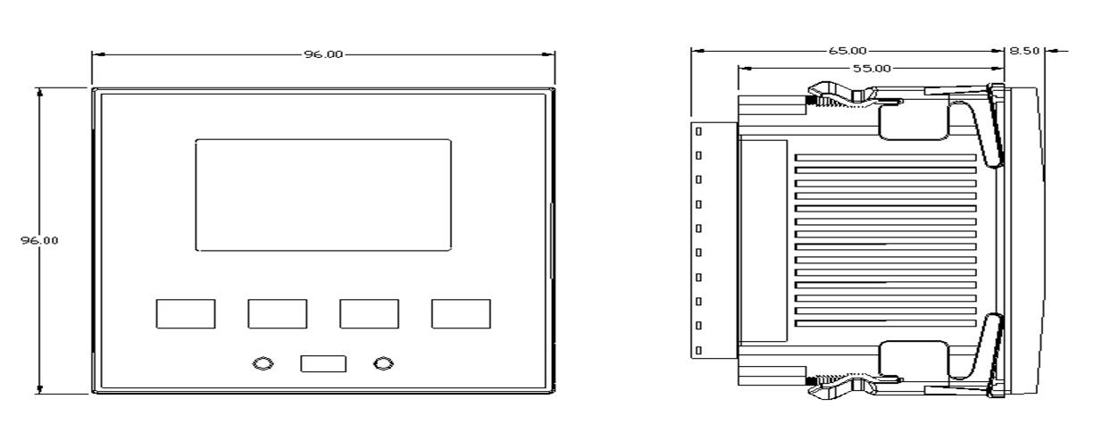
AUTOMATIC POWER FACTOR CONTROLLERS
DIMENSIONS
Front panel: 96x96mm
Depth: 65mm (with or without modules).

Slide 10
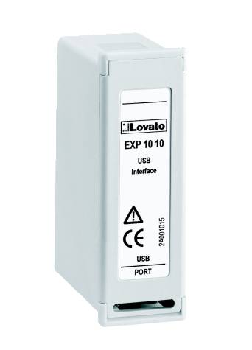
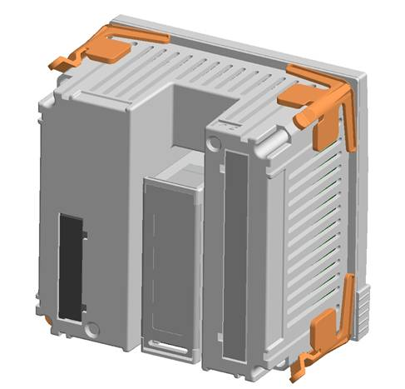
AUTOMATIC POWER FACTOR CONTROLLERS
EXPANSION MODULES
Plug-in connection at the back of the base unit
Power supplied by the base unit
  Increase the number of outputs
Add communication features.
Additional steps
EXP10 06:
2 415 VAC 1,5A relays
NO and COM contacts for each output.
Digital output modules
EXP10 03:
2 250VAC 5A relays
NC, NO and COM contacts for each output.
Communication modules
EXP1010 – Opto-isolated USB interface
EXP1011 – Opto-isolated RS232 interface
EXP1012 – Opto-isolated RS485 interface.

Slide 11
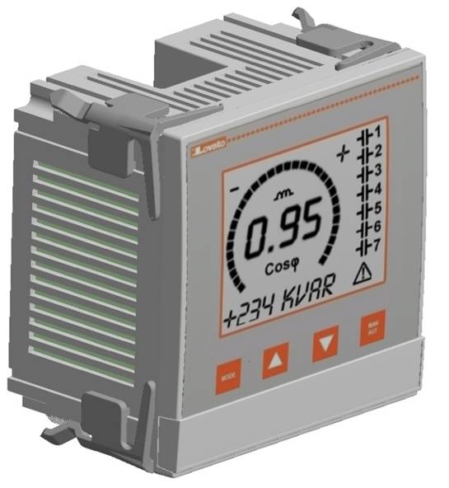
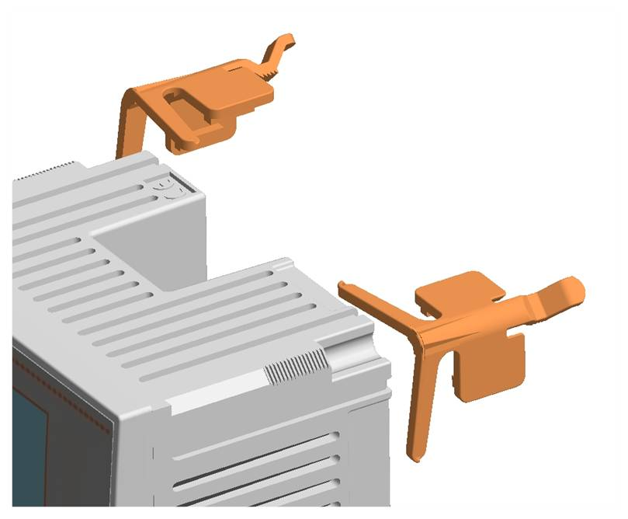
AUTOMATIC POWER FACTOR CONTROLLERS
tool-less installation
Fixing clips

Slide 12

AUTOMATIC POWER FACTOR CONTROLLERS
tool-less installation
EXP 8000
Removable plastic accessory for labelling

Slide 13
AUTOMATIC POWER FACTOR CONTROLLERS
MAIN CHARACTERISTICS
Auxiliary power supply
Rated voltage: 100…440VAC.
Voltage inputs
2 inputs (L1, L2)
Voltage range: 85…720VAC (L-L).
Voltage and current harmonic analysis
THDV
THDI
Approvals and compliance
IEC/EN 61010-1, IEC/EN 61000-6-2 IEC/ EN 61000-6-3
UL508 and CSA C22.2 n°14
cULus pending
EAC
Current inputs
1 input
CT secondary rated current:
/5A or /1A (selectable)
Current range:
125mA…6A (/5A), 25mA…1.2A (/1A)
Output relays
4 N/O + 1 C/O = 5 relays
(expandable up to 7 with EXP1006)
2 N/O + 1 C/O = 3 relays
(expandable up to 5 with EXP1006).

Slide 14
AUTOMATIC POWER FACTOR CONTROLLERS
SELLING POINTS
User Interface
Backlight icon display with more information
Excellent legibility on bad light condition
Backlight flashing in case of alarm
Viewing of texts, measurements, and alarms in 6 languages (English, Italian, French, Spanish, Portuguese, German)
Programmable bar graphs programmable.
Installation
Wide voltage range (85…720VAC) in compact size
The installation depth does not change with the EXP expansion installed
Installation without tools
Simple programming from front panel.

Slide 15
AUTOMATIC POWER FACTOR CONTROLLERS
SELLING POINTS
Application
Single-phase and three-phase installation
Cogenerating systems with dedicated setpoint
Medium voltage application with voltage transformers (VT)
Measurement viewing relevant VT primary
Device settings considering the primary side of the VTs (i.e. capacitor bank reactive power, protections, etc.)
2-level password to protect functions and parameter setup
Reduced number of switchings by algorithm
Equal usage of steps with the same reactive power
THDV, THDI measurement and harmonic analysis up to 15th order
Advanced protection for capacitor banks.

Slide 16
AUTOMATIC POWER FACTOR CONTROLLERS
SELLING POINTS
Expandability
Basic controller functionality can be easily extended using EXP series expansion modules
Increase number of steps
Adding communication features.
Optical communication port
Standard USB or Wi-Fi point
Communication with PC, smartphone, and tablet to carry out programming, diagnostics and data download without removing power to the electric panel.

Slide 17
AUTOMATIC POWER FACTOR CONTROLLERS
DCRL vs DCRK
DCRK3
DCRK3 240
DCRK3 440
DCRK3 480
DCRK3 525
DCRK5
DCRK5 240
DCRK5 440
DCRK5 480
DCRK5 525
DCRK7
DCRK7 240
DCRK7 440
DCRK7 480
DCRK7 525
CT secondary
/5A or /1A
without special code management
DCRL3
DCRL5
DCRL5 +
EXP1006

Slide 18
AUTOMATIC POWER FACTOR CONTROLLERS
DCRL vs DCRK
Measures Available | DCRL3/5 | DCRK3/5/7
Cos φ | ● | ●
Instantaneous power factor | ● | ●
Average weekly power factor | ● | ●
Voltage and current | ● | ●
Voltage and current Max | ● | ●
Electric panel temperature | ● | ●
Max electric panel temperature | ● | ●
Reactive power to reach set-point | ● | ●
Total reactive power | ● | ●
Capacitor overload | ● | ●
Max capacitor overload | ● | ●
Active and apparent power | ● | -
Current and voltage harmonic analysis | ● | -
THD capacitor current | ● | -
THDV, THDI | ● | -
var-measured value per step | ● | -
Number of switchings per step | ● | -
Connection time insertion per step | ● | -
Protections | DCRL3/5 | DCRK3/5/7
Over voltage | ● | ●
Under voltage | ● | ●
Over current | ● | ●
Over compensation | ● | ●
Under compensation | ● | ●
Capacitor overload | ● | ●
Over temperature | ● | ●
Mains micro-breakings | ● | ●
Programmable alarm property | ● | ●
Capacitor bank failure | ● | -
THDV max | ● | -
THDI max | ● | -
Protection password | ● | -
Maintenance request | ● | -

Slide 19
AUTOMATIC POWER FACTOR CONTROLLERS
NEW MEASUREMENTS AND PROTECTIONS
Active and apparent power
Current and voltage harmonics analysis
THD capacitor current
THDV,THDI
With the addition of these measurements and the alarms regarding THD max (voltage and current), the user can completely know the status of the system
This information can be helpful for advanced analysis in case of system anomalies to introduce the necessary corrections.
var-measured value per step
Number of switchings per step
Connection time per step
These measurements and the relative alarms, maintenance request and capacitor bank failure provide useful information for the power factor correction system supervision
This information can be used to schedule the maintenance of the installations.

Slide 20
AUTOMATIC POWER FACTOR CONTROLLERS
DCRL vs DCRG8
 | DCRL3/DCRL5 | DCRG8
User Interface
Display type | Backlight icon LCD | LCD graphic 128x80 pixel with backlight
Keys | 4 | 5
LEDs | - | 1 alarm led
Input
Voltage | 2 ph | 3 ph+N
Current | 1ph | 3 or 1ph
CT secondary | /5A or /1A | /5A or /1A
4 quadrant operation | ● | ●
LV and MV applications | ● | ●
Steps
Number of steps (relay) | 3 or 5 base unit 5 or 7 with EXP1006 | 8 base unit 10, 12, 14, 16 (with EXP)
Fast steps compatibility (transistor) | - | ● (with EXP1001)
Mixed transistor and relay configurations | - | 8 + 8
Other functions
Built-in temperature sensor | ● | ●
Input for ext. temperature sensor | - | with EXP
Event logging | - | ●
Master-Slave function | - | ●
Customisable internal variables | - | Limit thresholds Remote-controlled variables User alarms Energy consumption pulses Counters
 | DCRL3/DCRL5 | DCRG8
Setpoint
cos φ | 3 set point | ●
Generating cos φ | ● | ●
tan φ | ● | -
Housing
Dimensions | 96x96x65 mm | 144x144x44 mm (73mm with EXP)
IP protection degree | IP54 | IP54 (IP65 optional)
Operating temperature | -20...+60°C | -30…70°C
Storage temperature | -30...+80°C | -30…80°C
EXP compatibility
Communication interface
EXP1010 - USB | ● | ●
EXP1011 - RS232 | ● | ●
EXP1012 - RS485 | ● | ●
EXP1013 - Ethernet | - | ●
EXP1014 - Profibus DP | - | ●
EXP1015 - GPRS/GSM modem | - | ●
Additional steps
EXP1006 – 2 relays steps | ● | ●
EXP1001 – 4 static steps | - | ●
Digital I/Os
EXP1003 – 2 relays with 1 C/O each | ● | ●
EXP1000 – 4 inputs | - | ●
EXP1002 – 2 inputs + 2 static outputs | - | ●
Analog I/Os |  | ●
EXP1004 – 2 analog inputs | - | ●
EXP1005 – 2 analog outputs | - | ●
EXP1016 – Capacitor harmonic protection | - | ●

Slide 21
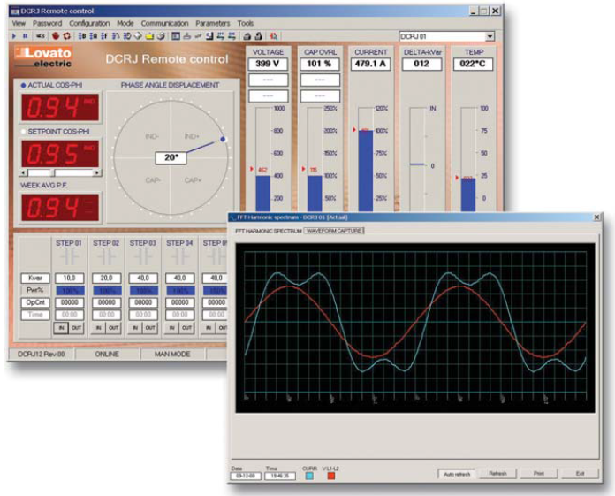
AUTOMATIC POWER FACTOR CONTROLLERS
SETUP SOFTWARE DCRJ SW
You can use the DCRJ Remote control software to transfer set-up parameters from the DCRL to the hard drive of the PC and vice versa and read the measurements.

Slide 22
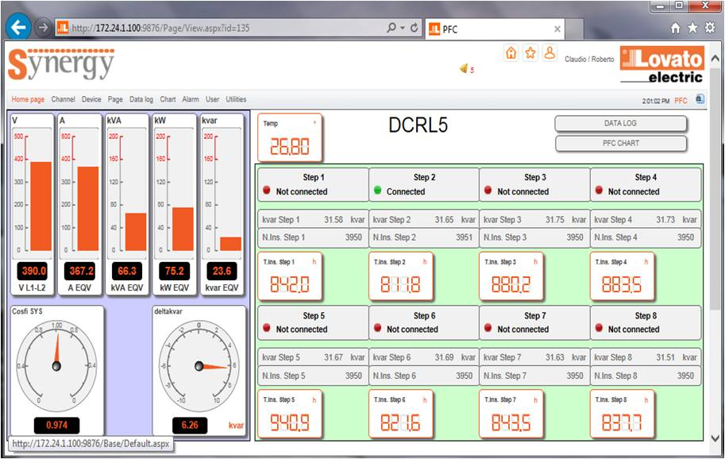
AUTOMATIC POWER FACTOR CONTROLLERS
SUPERVISION AND CONTROL SOFTWARE
Web based
Server – Multiclient structure
One software for many devices (multichannel)
Synergy is a supervision and control software for:
Electrical parameters (from voltage and current to energy)
Environmental and process parameters (temperature, pressure, flux).
Beyond providing data in tables and graphic pages, it offers:
alarm generation
chart plotting
command sending to devices.

Slide 23
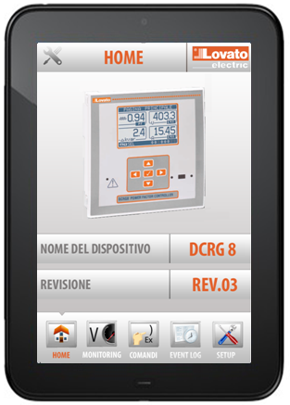
AUTOMATIC POWER FACTOR CONTROLLERS
APPLICATIONS FOR SMARTPHONES AND TABLETS
Lovato applications let the user:
Set up the device
Send commands to the device
Read values
Download statistics and events
Send the retrieved data by e-mail.
Wi-Fi connection between the smartphone/tablet and CX02
The user is guided to be connected to the device
Automatic application upgrade if an Internet connection is available
Compatible with iOS and Android.

Slide 24
AUTOMATIC POWER FACTOR CONTROLLERS
Thanks for your attention!
www.LovatoElectric.com

